Slide 1
Team 4
Design Group: F32
Team members:
MUHAMMAD SHAFIQ B NINABA
MUHAMMAD DANISH BIN MOHAMAD NASIR
NG SHENG FENG
LUO RUIQI
LIU MOJIA
LIM XIN YI IRIS
Food Categories:
Bak Chor Mee | Kaya Toast and Egg | Nasi Lemak | Oyster Omelette | Roti Prata | Satay

Slide 2
Table of contents
Exploratory Data Analysis and Data Augmentation
Models
Results
Advanced Requirements
Conclusion

Slide 3
01
Exploratory Data Analysis

Slide 4
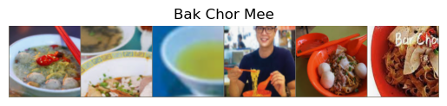
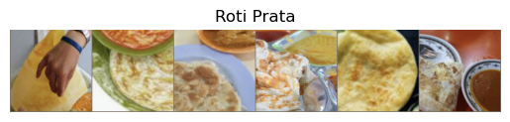
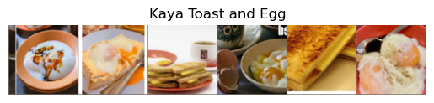
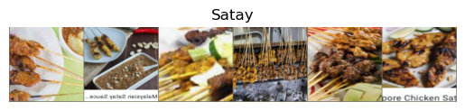
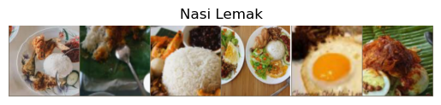
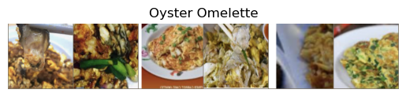
6 Food categories
Notes:
our dataset comprising images of six distinct food categories.

Slide 5
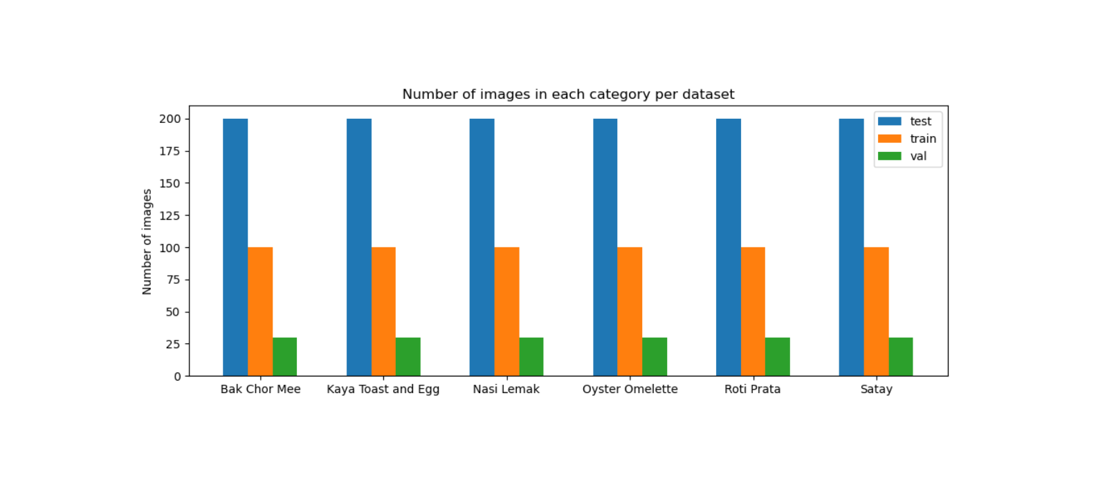
Notes:
Here, we analyze the distribution of images across our dataset. EDA ensures that we have balanced data, which is pivotal for training unbiased models. The bar chart exhibits the count of images per category, divided into training, validation, and test sets – a crucial step for recognizing any skewness or imbalance.

Slide 6
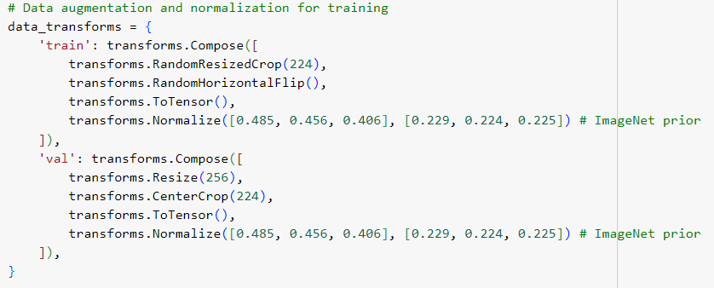
Data augmentation
Notes:
Data augmentation technique was used to increase the variety and diversity of data to the model, hence enhancing its ability to generalize unseen data and allows for better classification performance for the validation and test dataset.

Slide 7
02
Models

Slide 8
Models
CNN from Scratch
Not pre-trained
Serves as the baseline model for comparison of results to other pre-trained models
Basic layers i.e. convolution, pooling and fully connected layers
InceptionV3
Wide architecture which handles complex image data efficiently
Allows the model to capture information at various scales
Minimizes computational waste by adapting filter sizes and operations to the content of the image

Slide 9
Models
ResNet101
Introduces skip connections, which aids in gradient flow and network optimization
A deep architecture that is able to learn more complex features and patterns in images
DenseNet121
Layers connected in feedforward, bottleneck layers
Reduce computation load w/o reducing features

Slide 10
Models
VGG16
Architecture Overview: Sequential convolutional layers and pooling layers
Key Features: Deep layers through stacking small 3x3 convolutions.
Simplicity and scalability: Effective for high-level feature learning.
MobileNetV3
High Efficiency: Depthwise separable convolutions that reduce computational cost, ideal for real-time and mobile applications.
Advanced Architecture: Squeeze-and-Excitation blocks and Hard Swish activations to enhances feature representation and efficiency.

Slide 11
03
Results

Slide 12
 | Train Acc | Train Loss | Val Acc | Val Loss | Training Time
CNN | 0.200 | 1.775 | 0.228 | 1.765 | 0m 31s
ResNet101 | 0.775 | 0.661 | 0.817 | 0.604 | 6m 46s
VGG16 | 0.723 | 0.876 | 0.822 | 0.618 | 7m 55s
DenseNet121 | 0.640 | 1.3158 | 0.700 | 1.194 | 4m 35s
InceptionV3 | 0.730 | 1.357 | 0.756 | 1.072 | 6m 01s
MobileNetV3 | 0.593 | 1.387 | 0.683 | 1.269 | 1m 28s
Notes:
We trained the models on 5 epochs and batch size of 64, all with cross entropy loss and stochastic gradient descent (SGD) optimizer
Based on consolidated test results,
Resnet best accuracy overall
Worst is self built cnn
Note that mobilenet training time is much faster compared to other pretrained m. due to its lightweight mentioned by iris

Slide 13
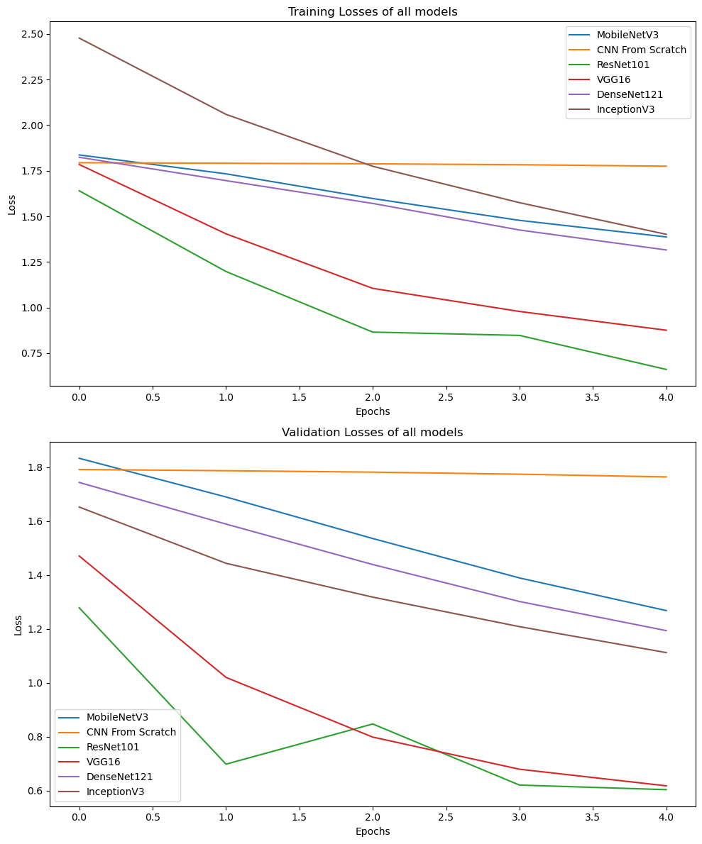
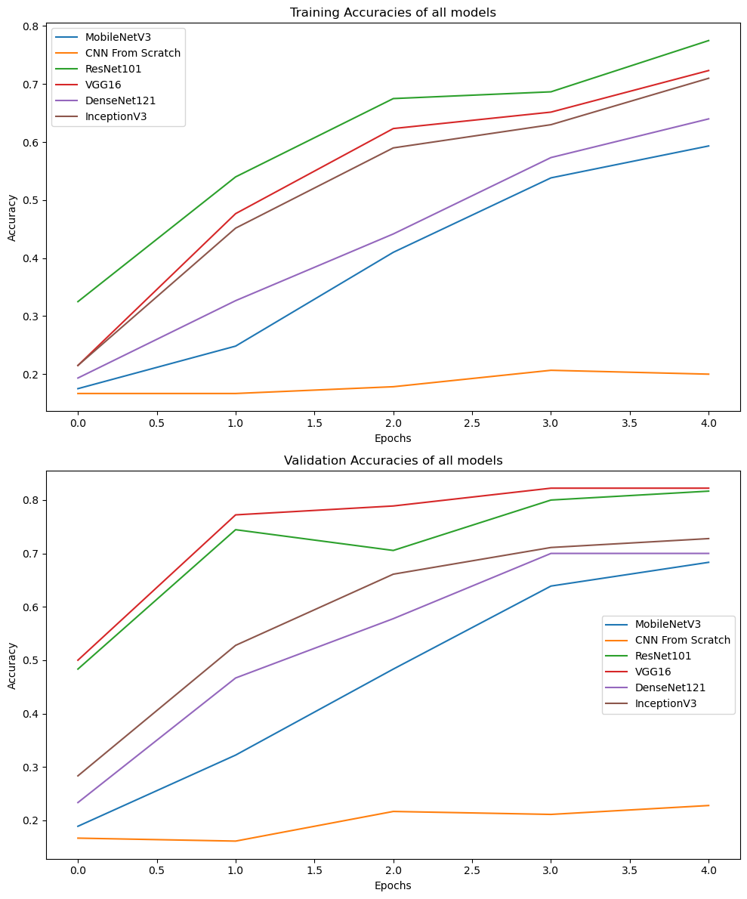
Notes:
We can see the resnet101 training and validation loss decreasing the most
While the self built CNN barely improves

Slide 14
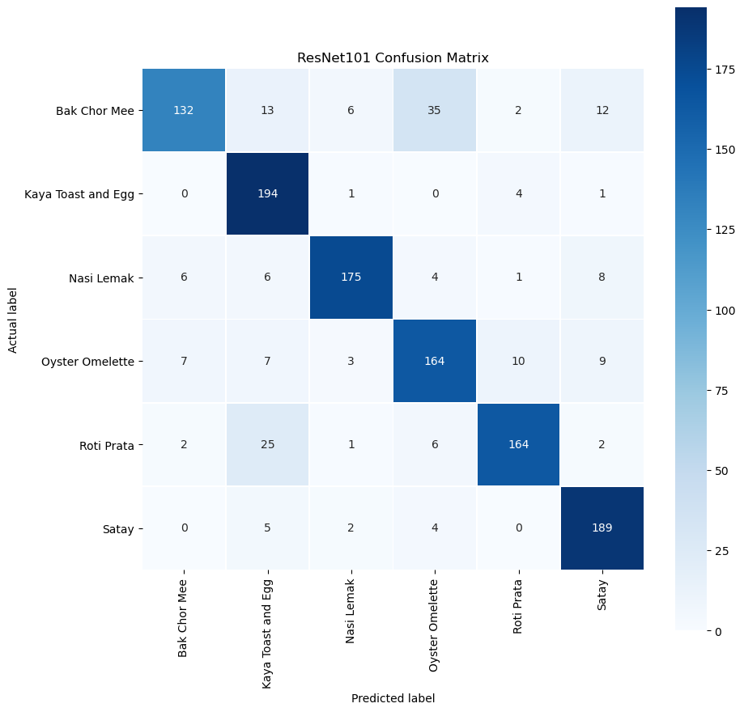
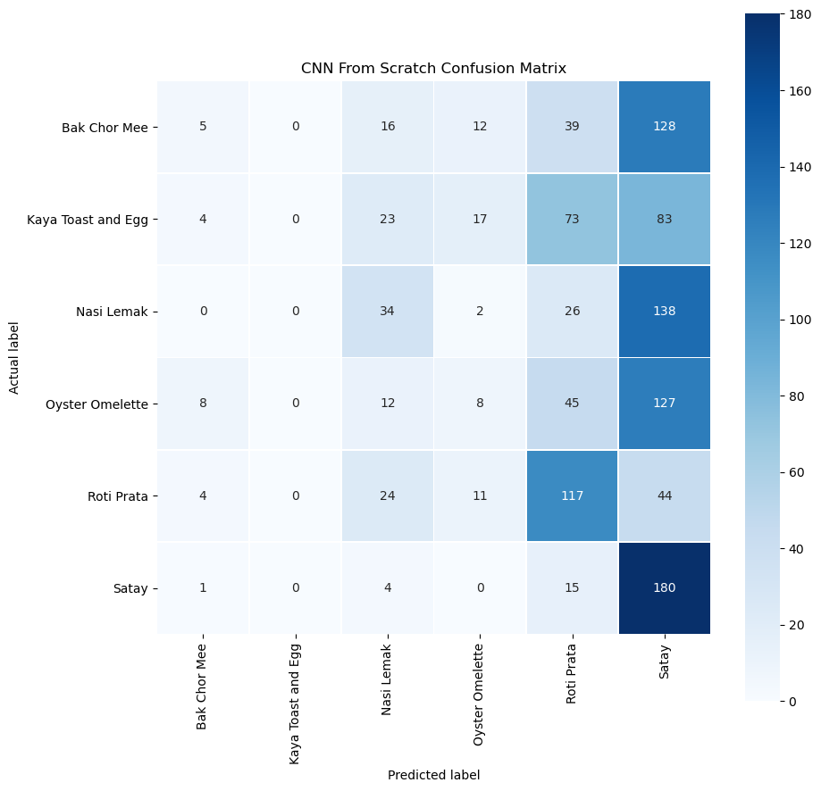
Notes:
Compared to high accuracy of resnet101,
Self built cnn can mostly classify satay and roti prata correctly
But looking closely, the cnn is heavily biased to satay and roti prata with most wrong predictions classified as them
Could be due to satay and roti prata heaving distinct outlines and cnn layers not being deep enough

Slide 15
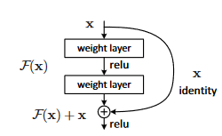
Possible explanations for the best model
Skip Connections:
Input skips every few layers and is added into the mapping
Enables residual learning; captures difference between current approx. vs desired output
Allows loss gradients to backpropogate directly to earlier layers to update weights
Notes:
Resnet101’s accuracy could be due to its feature of residual learning.
By implementing skip connections every few layers and adding the input to the mapped output of previous layers,
It allows the model to capture differences between the current approximated output with the desired output where,
The loss gradients are backpropogated easily to earliers layers through the skip connections and update the weights.
This allows earlier layers to be updated accordingly and prevent gradient vanishing/ explosion.

Slide 16
04
Advanced Requirements
Notes:
Thank you Danish. I’ll now be explaining the advanced requirements that were explored for this project.

Slide 17
Methods explored
MobileNetV3
Handle untrained classes
Increase accuracy
Data augmentation
Unfreezing more layers
Speed up training time
Batch size
Notes:
For this portion, we chose to experiment on MobileNetV3 as it has one of the lowest accuracy scores, which means that we have a lot of room for improvement and we can see the effects of these methods to a greater extent.
We explored handling untrained classes.
We tried to improve the accuracy of the network, by exploring methods such as data augmentation and unfreezing more layers.
We also tried to reduce the training time, by changing hyperparameters such as exploring with different batch sizes.

Slide 18
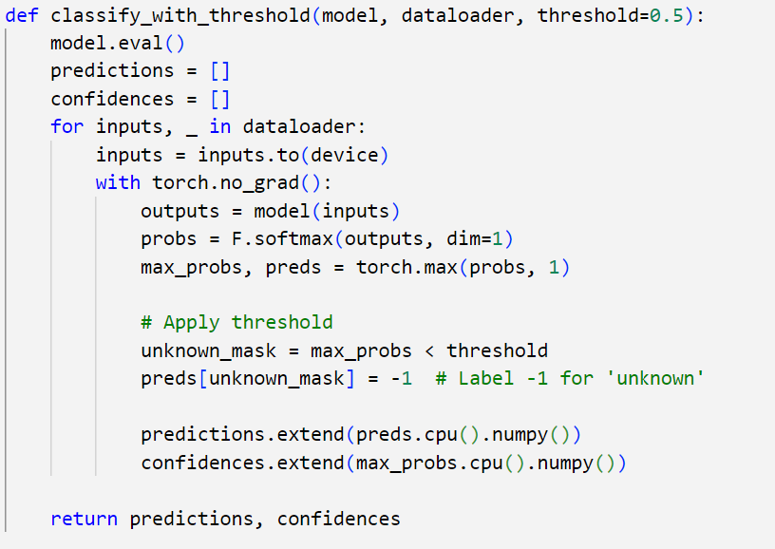
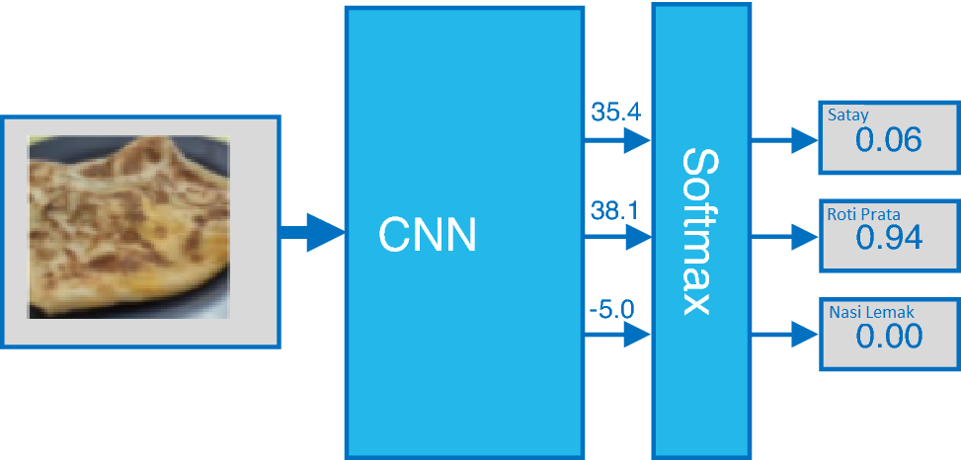
Handling untrained classes
Softmax implementation
Threshold setting
Notes:
This slide shows the method that was explored to handle classes that were untrained.
As shown in the code snippet here, we used a threshold setting on the softmax outputs.
The softmax function converts the raw output logits from the neural network into probabilities, which sum up to 1 across all classes. These probabilities are then compared against a predefined threshold, say 0.5 in this case.
If the highest softmax probability for a prediction is greater than 0.5, the model is considered confident, and the image is classified into one of the known classes.
If it’s not, the image is labeled as 'unknown', effectively handling classes that were not part of the training set.

Slide 19
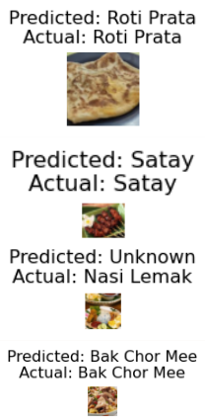


Predictions: [-1, -1, -1, -1, -1, -1, -1, -1, 2, -1, -1, -1,...
Confidences: [0.3329508, 0.27950442, 0.24824084, 0.27490872, 0.31256047, 0.27703485, 0.21682662, 0.4710576, 0.5410289, 0.3843939, 0.35013956, 0.31237042,...
Notes:
As you can see here, the model output a bunch of -1 for unknown and if the probability is above 0.5 as highlighted in green, the prediction will appear.
For example, Laksa was not included in our training, hence it received a low confidence score, and was predicted as unknown.
However you can see that in some cases, like this, even though kaya toast and egg was part of our training, it still predicted as unknown due to a low confidence score.
Another method that is possible is to include another category, called “unknown” and include some images from other classes during model training.
However in a real-world application, we might not have the luxury of resources to be able to generate or collect images that are not part of the desired classes.
However, this might mean that it might classify food that has been trained as unknown if the confidence is low.

Slide 20
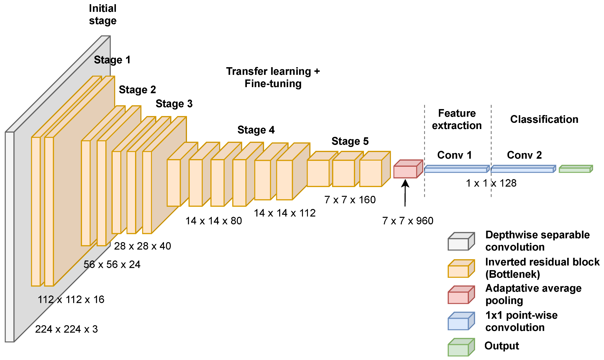
Unfreezing more layers
Unfreeze last 5 layers of feature extraction
Accuracy increased from 0.683 to 0.883
# Unfreeze some of the later layers of the model
for param in model_conv.features[-5:].parameters():
param.requires_grad = True
Notes:
The next method that we explored was to unfreeze more layers, specifically the last 5 layers of feature extraction, as shown in the diagram here.
Unfreezing more layers allows the pretrained model to adapt its more complex, intermediate features that are specific to the new dataset, leading to better performance on classifying the food images.
This led to an increase in accuracy, from 0.683 to 0.883
Since the later layers of a CNN capture more abstract features; unfreezing them lets the model adjust these features to better match the visual patterns of the target food images.

Slide 21
Speeding up the training process
Batch sizes of 128, 32, 16 were explored
Validation accuracy did not increase as much
Training time did not change much
Batch Size | Val Acc | Training Time
16 | 0.822 | 3m 36s
32 | 0.817 | 3m 27s
64 | 0.883 | 3m 38s
128 | 0.806 | 3m 29s
Notes:
The previous method of unfreezing more layers took longer to train, so we tried to explore different batch sizes to speed up the training process.
However, the results were quite inconclusive, as the validation accuracy did not increase as much, and the training time did not change either.
In fact, the validation accuracy reduced throughout the rest of the batch sizes.
I will now pass the time over to Mojia to conclude our presentation.

Slide 22
05
Conclusion

Slide 23
Conclusion
Accuracy Improvement:
Effective Techniques
Challenges & Learnings
MobileNetV3's accuracy enhanced from 0.683 to 0.883 through strategic modifications.
Data augmentation
Adjustment of softmax threshold
Unfreezing the last 5 layers
Complexities of model optimization
Hyperparameter fine tuning
Notes:
Our attempt to improve the performance of MobileNetV3 has shown significant insights and outcomes. By implementing strategies such as data augmentation, adjusting the softmax threshold, and unfreezing additional layers, we've effectively increased the model's accuracy from 0.683 to an impressive 0.883. This suggests the model's enhanced capability to adapt to more complex, specific features of our dataset
However, as our experiments with varying batch sizes have shown, not all modifications lead to clear benefits. This reflects the challenging nature of machine learning where optimal settings can vary significantly across different model architectures.
We have taken an extra step to recognise 'unknown' classes not seen during training. We have grown to appreciate the developing models that are versatile in unpredictable environments.
Thank you for your attention. We now welcome any questions you may have about our methods and findings.

Slide 24
Q&A
Thank You!

Slide 25
Individual Contribution
 | Shafiq* | Danish | Sheng Feng | Ruiqi | Mojia | Iris
CNN |  |  | ╳
ResNet101 |  |  |  |  |  | ╳
VGG16 |  |  |  | ╳
DenseNet121 |  | ╳
InceptionV3 |  |  |  |  | ╳
MobileNetV3 | ╳
Presentation | ╳ | ╳ |  | ╳ | ╳
Slides | ╳ | ╳ | ╳ | ╳ | ╳ | ╳
Advanced Requirements | ╳
* Team Leader

